Slide 1

Transfer Learning
Dr. Ahmed Yousry

Slide 2
Outline
Motivation
The Basics idea for Transfer Learning
Formal Definition
Transfer Learning Strategies
Keras applications
Simple example

Slide 3
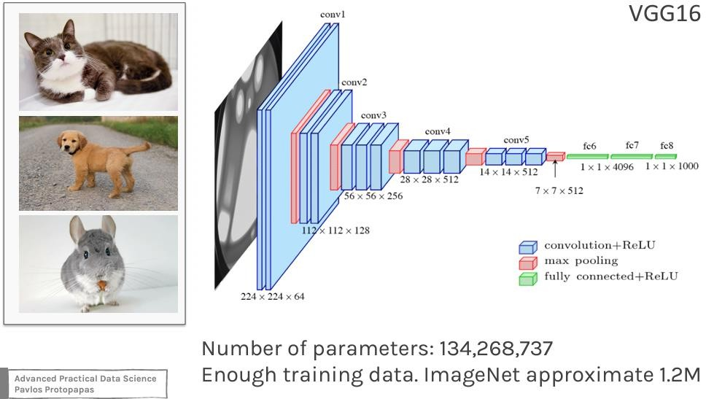
Classify Cats, Dogs, Chinchillas etc

Slide 4
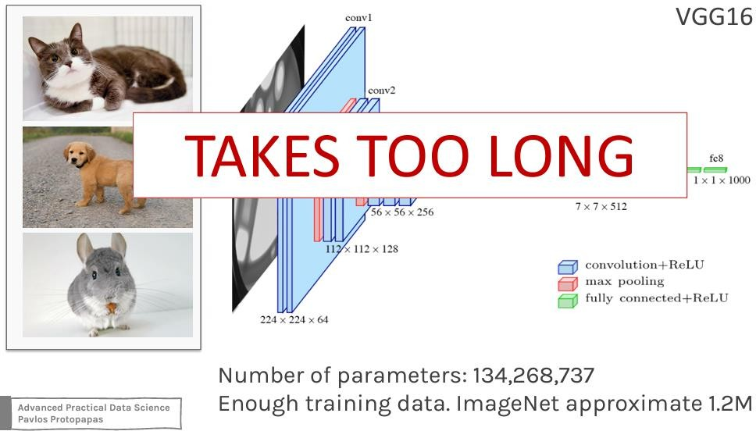
Classify Cats, Dogs, Chinchillas etc

Slide 5
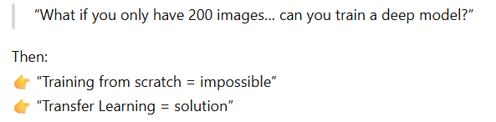
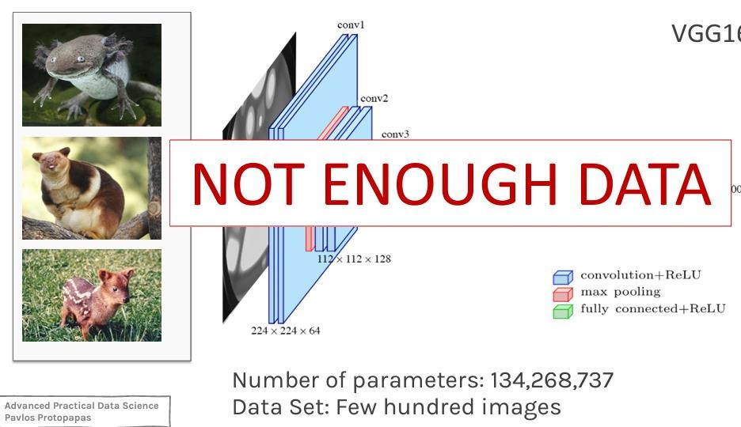
Classify Rarest Animals

Slide 6

Transfer Learning to The Rescue
How do you build an image classifier that can be trained in a few minutes on a CPU with very little data?

Slide 7
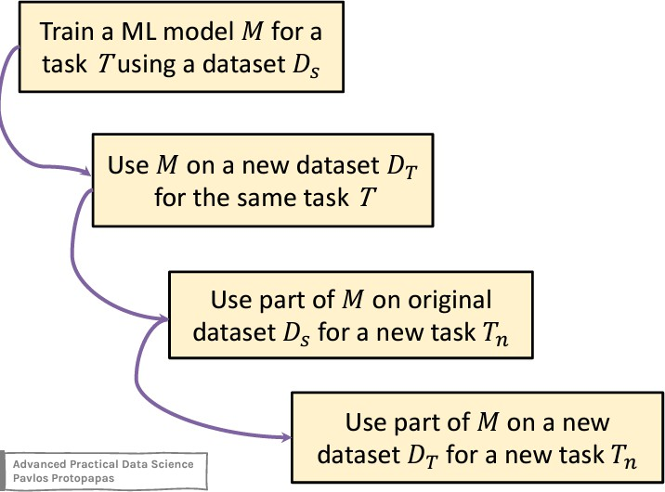
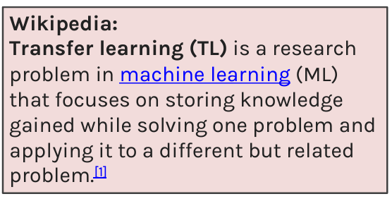
Basic idea of Transfer Learning

Slide 8
Basic idea of Transfer Learning (cont)
How do you make an image classifier that can be trained in a few minutes on a CPU with very little data?
Use pre-trained models, i.e., models with known weights.

Slide 9

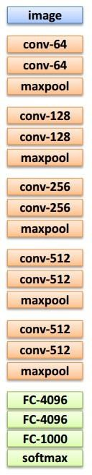


+
58
2. Small dataset:
3. Medium dataset:
1. Train on
Imagenet
more data = retrain more of the network (or all of it)
Freeze these
Freeze these
Train this
Train
this

Slide 10
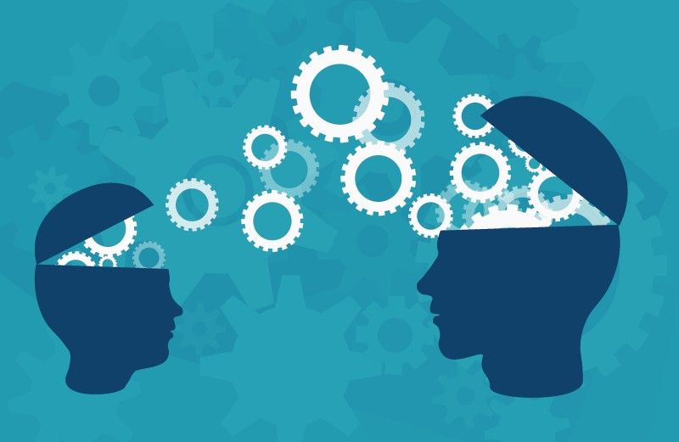
+
59
What Is Transfer Learning?
In transfer learning, the knowledge of an already trained machine
learning model is applied to a different but related problem.
The general idea is to use the knowledge of a model (that learned from a task with a lot of available labeled training data) in a new task that doesn't have much data.
Instead of starting the learning process from scratch, we start with patterns learned from solving a related task.

Slide 11










+
60
In neural networks dealing with images, usually try to detect edges in the earlier layers, shapes in the middle layer and
In transfer learning, the early and middle layers are used, and we only retrain the task-specific layers. It helps influence the labeled data of the task it was initially trained on.
The task 1 and task 2 must have the same setting for input.

Slide 12
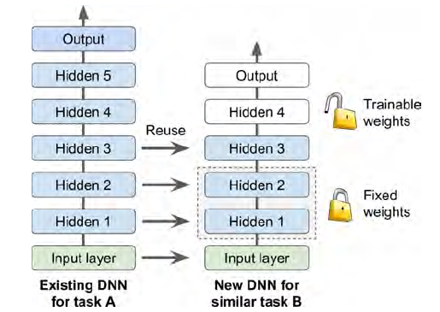
Example
DNN that was trained to classify pictures into 100 different categories.
want to train a DNN to classify specific types of vehicles.
Freezing the Lower Layers weights.
Tweaking, Dropping, or Replacing the Upper Layers.

Slide 13
Fine-tuning
Definition: Adjust a pre-trained model to better fit a new task
How it works:
Keep early layers (general features)
Retrain some or all later layers
Approaches:
Train only final layers (fast)
Fine-tune top layers (better accuracy)
Fine-tune entire model (needs more data)
Example: Use an ImageNet model → fine-tune it on a small custom dataset

Slide 14
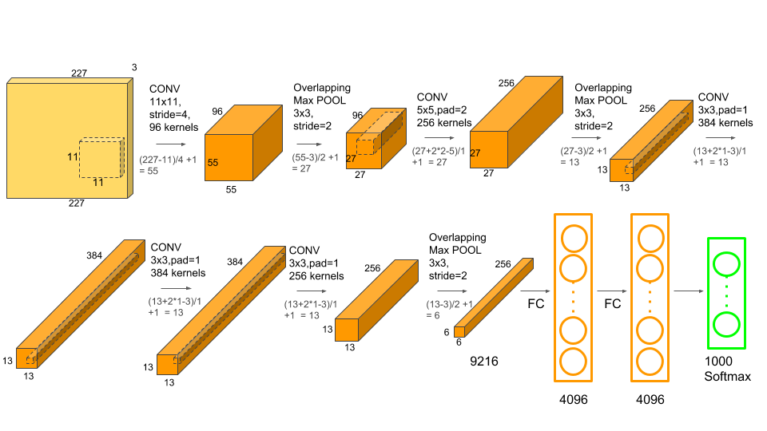
Understanding AlexNet
Consists of 5 Convolutional Layers and 3 Fully Connected Layers (classify 1000 classes)

Slide 15
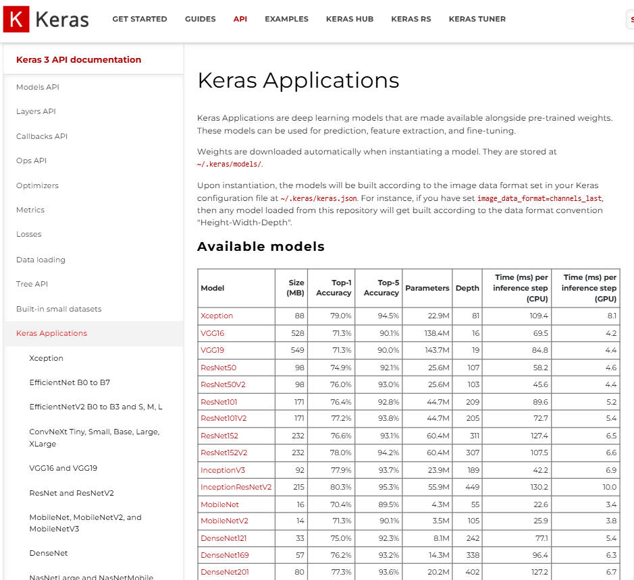
https://keras.io/api/applications/

Slide 16
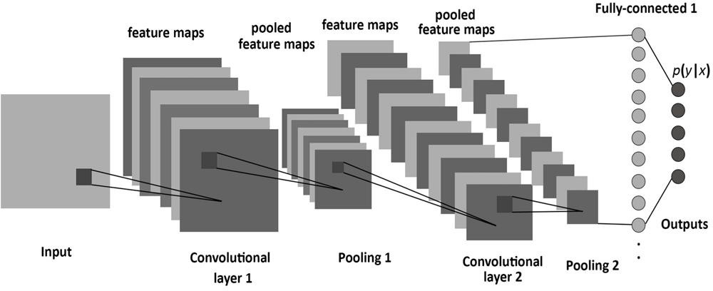
Extremely short review of CNN

Slide 17
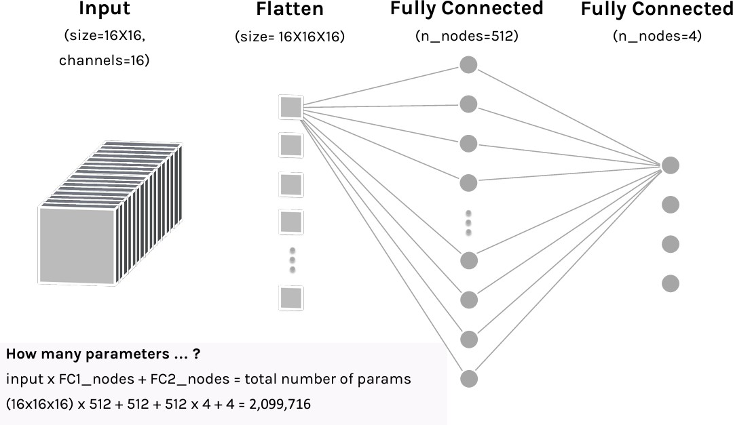
Calculate the number of parameters

Slide 18
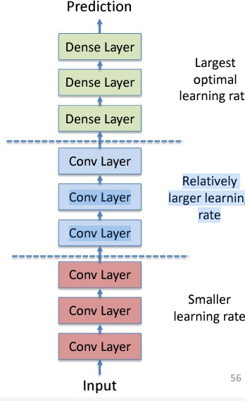
Transfer Learning for Deep Learning: Differential Learning Rates
A low learning rate can take a lot of time to train on the "later" layers. Since we trained the FC head earlier, we could probably retrain them at a higher learning rate.
General Idea: Train different layers at different rates.
Each "earlier" layer or layer group (the color-coded layers in the image) can be trained at 3x-10x smaller learning rate than the next "later" one. Conv Layer Conv Layer Relatively larger learning rate
One could even train the entire network again this way until we overfit and then step back some epochs.

Slide 19
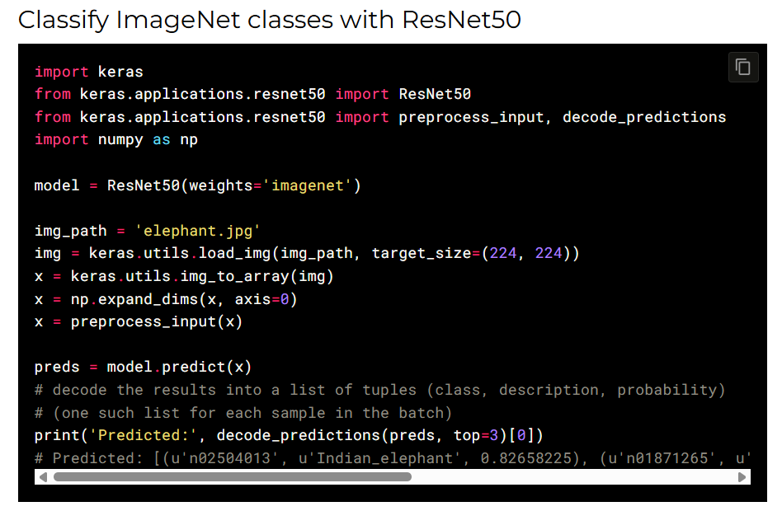
Practical example

Slide 20
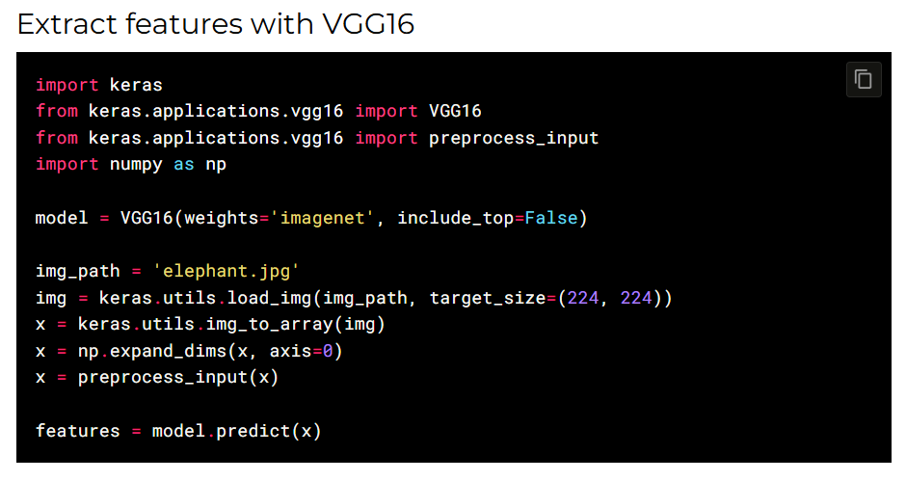

Slide 21
Thank You!

